Slide 1
Aztec, Mayan and Incas Comparison

Slide 2
*Relgion
All 3 were polytheistic-belief in many gods

Slide 3
*Comparison to Ancient Civilization
*A major difference between the pre-Columbian (Mesoamerican) civilizations and the ancient civilizations of Egypt and Mesopotamia is that the pre-Columbian civilizations did not develop in River Valleys

Slide 4
*Written Language
*The Aztec, Incas and Maya were considered civilized because they developed a written language

Slide 5
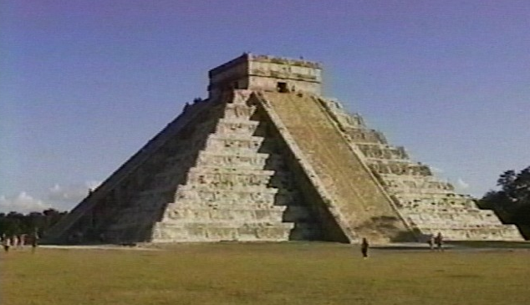
*Science and Technology
*The Aztec calendar and the Maya use of zero both illustrate that Mesoamerican cultures in the Americas made advances in science and technology
*Had the engineering skill to build complex structures
*They flourished prior to European contact

Slide 6
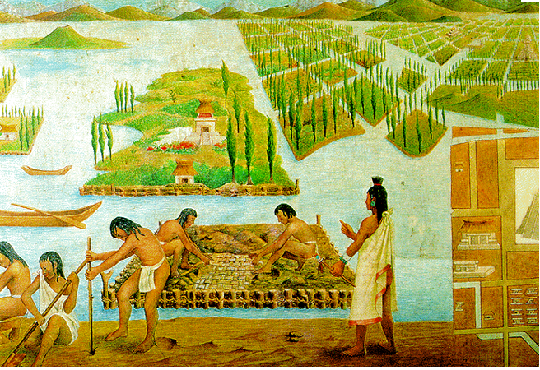
*Agriculture
*A study of the Aztec, Maya and Inca agricultural systems would show that these civilizations adapted to their environment with creative farming techniques

