Slide 1
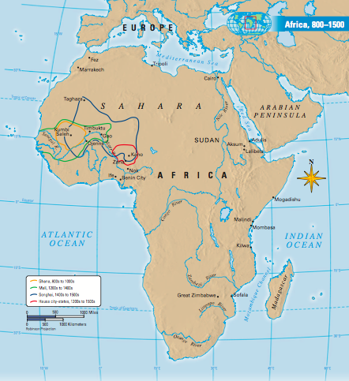
North and Central African Societies
Chapter 15 section 1

Slide 2
Main Idea
North and Central Africa developed hunting-gathering societies, stateless societies, and Muslims states

Slide 3
Why It Matters Now
Modern African nations often must find ways to include these various peoples and traditions into one society.

Slide 4
Hunting Gathering Societies
Oldest form of social organization in the world began in Africa
Rely on hunting and gathering for survival

Slide 5
Efe (Forest Dwellers)
Hunters and gatherers
Ituri Forest in the Democratic Republic of Congo
Small nomadic group, all related and own their own grass & brush shelter
Efe women are gathers, men/boys are the hunters

Slide 6
Efe continued…
Group leader is a respected male (father, uncle, father-in-law), but does not act like a chief (does not give orders)
Disagreements are settled through discussion. If conflict is still not resolved one member can decide to leave
Daily life not governed by formal written laws, but logical guidelines.

Slide 7
*Stateless Societies
Family organization is central to African society
Organized into lineage-believe they are descendants of a common ancestor (including past and future generations)
Strong loyalty to one another
*This political system was common in sub-Saharan Africa before the arrival of the Muslims and Europeans

Slide 8
Stateless Society…
South of the Sahara, African groups developed a system of governing based on lineage
Stateless society is where lineage groups took the place of rulers but did not have a centralized system of power
Power was balanced so no one family had too much power
Conflict was resolved by the ruling of the group’s elder leader

Slide 9
Tracing Family Descent
Patrilineal- society traces their ancestors through their fathers, inheritance passes from father to son.
*Matrilineal-society where children trace their ancestors through their mother, young men inherit land from their mother’s family

Slide 10
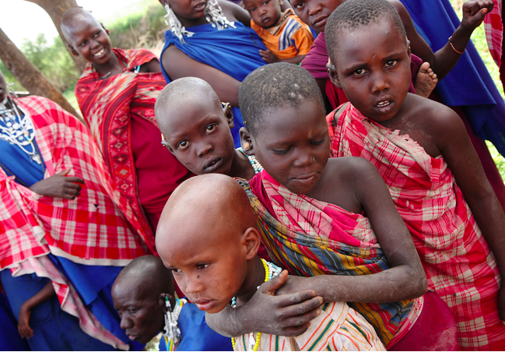
*Age Set System
Age set consist of young people within a region who are born during a certain time period.
Each age set passes together through clearly identified life stages, such as warrior or elder.
Ceremonies mark the passage of each age set.
*Duties and roles associated with varying ages

Slide 11
Muslim States
Islam played a major role in North African political history
After Muhammad’s death in 632, Muslims swept across the northwest part of Africa
Muslim theocracies of Africa are established in the North
By 670, Muslims ruled Egypt and Maghrib (Mediterranean coast of Morocco, Tunisia and Algeria)
As Africans converted to Islam they changed their government to Islamic Law

Slide 12
Islamic Law
Obligated to follow religious law
Helped unify individual states that had ethnic or cultural differences
Islamic law had been a significant force politically and socially in African history.
Berbers (original inhabitants of N. Africa) converted to Islam while still maintaining their loyalties and identities.
Two Berber groups (Almoravids and Almohads) united the Maghrib under Muslim rule.

Slide 13
Almoravid Reformers
Founded in 11th century, lived in western Sahara
A devout Berber Muslim made a hajj to Mecca
On his way home he convinced a Muslim scholar to return with him to teach his people about Islam
His teaching attracted many followers and a strict religious brotherhood (Almoravids) was founded.

Slide 14
Almohads Take Over
mid 1100’s the Almohads (Berber Muslims reformers) took power from the Almoravids.
Began a militant religious movement
Followed the teachings of Ibn Tumart who denounced other rulers for practicing non traditional Islam.
Urged his followers to follow the Qur’an and Islamic law
Lasted over a 100 years and united the Maghrib under one rule for the first time

Slide 15
Quick Review
In what type of system are duties and roles associated with varying ages?
In what type of society do children trace their ancestry through their mother and young men can inherit land and wealth from their mother’s family?
What type of political system was common in sub-Saharan Africa before the arrival of the Muslims and Europeans?

Slide 16
Quick Review
In what type of system are duties and roles associated with varying ages? Age Set
In what type of society do children trace their ancestry through their mother and young men can inherit land and wealth from their mother’s family? Matrilineal
What type of political system was common in sub-Saharan Africa before the arrival of the Muslims and Europeans? Stateless Society

