Slide 1
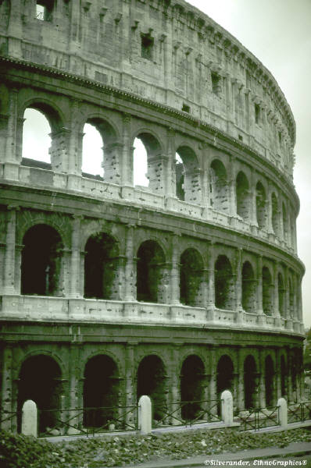
The Roman Empire Brings Change
Ch 6 Sec 2

Slide 2
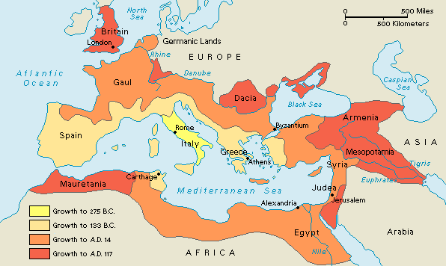
Romans Create a Republic

Slide 3
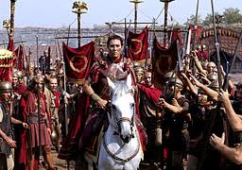
Roman Republic Collapses
Punic Wars Caused an expanding empire, many problems
  Conflict between rich and poor
  Civil War broke out
  Leading generals fought for power

Slide 4
The Rise of the Generals
Generals recruited the very poor to be soldiers
Owed loyalty to general not to State of Rome.

Slide 5
First Triumvirate
Triumvirate
  A group of 3 leaders sharing control of the government
First Triumvirate
  Julius Caesar
  Pompey
  Crassus

Slide 6
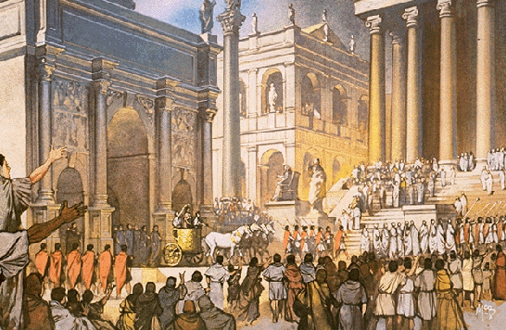
Julius Caesar
Caesar gained fame with victories in Gaul
Pompey feared Caesar
They fought in a civil war that lasted several years
Caesar won the civil war and governed as ABOSOLUTE RULER.
*The Roman Empire differed in importance from the Roman Republic because political power was held primarily by one person

Slide 7
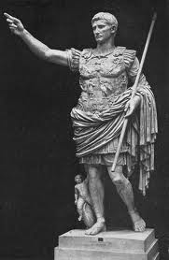
Death of Julius Caesar
Some members of Roman senate feared Caesar
The Romans had always hated kings
Many feared that Caesar’s new title, Dictator for Life, meant another king
He was assassinated during the “Ides of March?

Slide 8
Horrible History-Crime Watch
http://www.youtube.com/watch?v=6nuwEH-v0Bc
http://www.youtube.com/watch?v=eyq8uWvpbt4

Slide 9
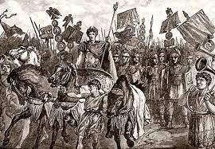
Augustus rises as new leader
Rome suffered another civil war
Caesar’s nephew, Octavian, fought for power with Caesar’s best friend Mark Antony
Octavian won, and took the title Augustus which means “exalted one”

Slide 10

PAX ROMANA – 27 B.C. – 180 A.D.
PAX ROMANA = “ROMAN PEACE”

Slide 11
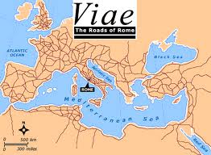
What was the “Pax Romana”
*200 year period of peace & prosperity
60-80 million Roman population
Empire stretch from the Mediterranean, from modern Syria and Turkey west and north to England and Germany
90% of the people were farmers
Trade was very important
Goods traveled by ship and extensive road system
Trading ships were protected by the Roman Navy

Slide 12
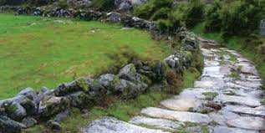
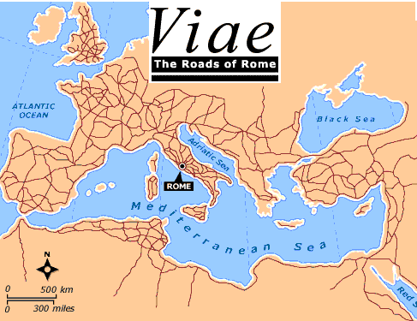
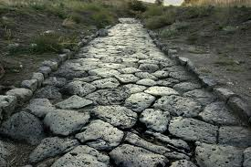
*Roman Roads
*“All Roads Lead to Rome” was a common saying
-Rome was able to deploy the legions throughout the empire
-The new Christian religion was spread throughout the empire
-Rome was the center of trade

Slide 13
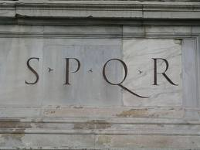
End of Pax Romana
Augustus was Rome’s ablest ruler
Between A.D. 96 and A.D. 180 the Five Good Emperors ruled Rome
The death of Marcus Aurelius in A.D. 180 marked the DECLINE of the Roman Empire and the end of the Pax Romana

Slide 14
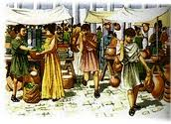
Life in Imperial Rome
Roman valued discipline, strength, and loyalty
Family was center of Roman society
*Women enjoyed some legal rights in Rome, more than other ancient cultures
  *They could own property
  Testify in court
  *Make wills
  They could not vote
  Wealth children went to school
  Poor children worked and did not go to school.

Slide 15
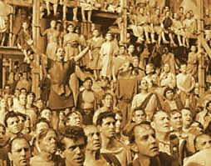
Life in Imperial Rome
Your quality of life depended on your social position
The poor had little food and no jobs
Rulers kept the “Mob” under control by providing free food and entertainment

Slide 16
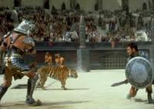
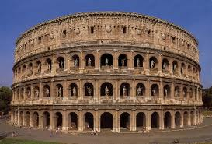
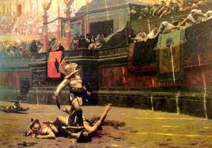
Gladiators
Slaves came from conquered lands
Some slaves were forced to become GLADIATORS
Gladiators were professional fighters who fought to the death in public contests.
They fought in the Roman Coliseum

Slide 17
Horrible History-Gladiator School
http://www.youtube.com/watch?v=CWCwnkdPPCc

Slide 18
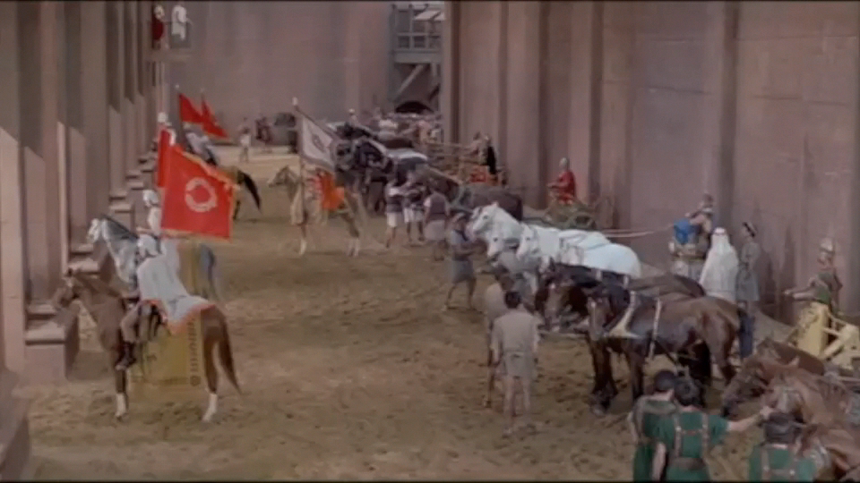
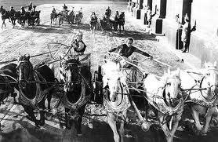
Chariot Races

Slide 19
Mastery Check:
Which of the following contributed to stability in Rome during the Pax Romana?
Disruption of trade
High Taxes
Roman Road System
Declining interest in public affairs

