Slide 1
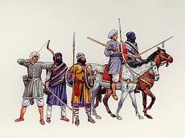
Kingdoms of Ghana, Mali, and Songhai
Ch. 15 Sec. 2

Slide 2
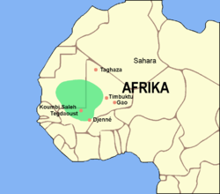
Kingdom of Ghana
People started using Camels in trade because they could last longer without water
Kingdom of Ghana began to grow rich from taxing goods that were carried through their region

Slide 3
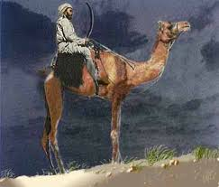
Kingdom of Ghana
Gold & Salt were two most important items
*The trade across the Sahara Desert between the Arab merchants and West African Kingdoms were primarily based on the exchange of Gold and Salt
Gold – two-thirds of the world’s gold supply came from West Africa
Salt – Essential to human life and plentiful in the Sahara desert

Slide 4
*Based on the map, which conclusion can best be drawn about this region?
The Sahara Desert acted as a barrier to trade
Rivers served as the primary trade routes for the entire region?
The economy of the region was influenced by extensive trade connections
Goods from the Gulf of Guinea were exchanged directly with Italian cities.

Slide 5
*Based on the map, which conclusion can best be drawn about this region?
The Sahara Desert acted as a barrier to trade
Rivers served as the primary trade routes for the entire region?
The economy of the region was influenced by extensive trade connections
Goods from the Gulf of Guinea were exchanged directly with Italian cities.

Slide 6
Islamic Influence
Islam spread through North Africa by conquest, but south of the Sahara, Islam spread through trade
Muslim merchants and teachers settled in the states south of the Sahara and introduced their faith
Ghana rulers converted to Islam
By the 11th century, Muslim advisers were helping the king run the kingdom

Slide 7
*Impact of Muslim Expansion into West Africa
*The interaction of Muslim traders with the civilization of West Africa had a tremendous impact
*Expanded the influence of Islamic beliefs
*Increased trade of gold and salt
*The rise of Civilization of Ghana and Mali
*West Africa trade routes were similar to the impact of the Silk Road in Asia because ideas were exchanged as merchants interacted with each other.
*The expansion of Islam into Africa caused numerous political, economic and social changes.
*Economic example: Sub-Saharan Africa and West Africa was pulled into the Arab trading zone.

Slide 8
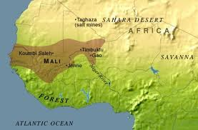
Empire of Mali
Wealth was built on gold
New deposits of gold were found so trade routes started to go through Mali
Helped trade Gold and Salt throughout North & West Africa

Slide 9
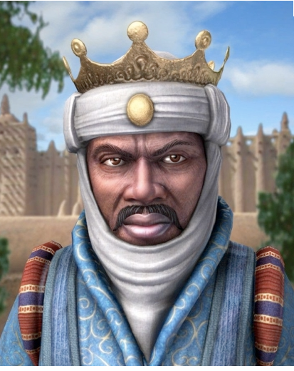
Empire of Mali
Mansa Musa – Mali’s most famous ruler
Skilled military leader
Expanded empire to twice the size of Ghana

Slide 10
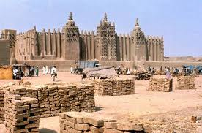
Mali’s Golden Age Under Mansa Musa
*Lead Mali to a “Golden Age”
*Commissioned great mosques to be built in Timbuktu, Mali’s capital, and other Mali cities.
*Muslim scholarship flourished and Timbuktu became a center of learning
*Public display of wealth and power enhanced Mali’s reputation and prestige throughout the world.
*One conclusion that can be reached from the evidence about Mansa Musa’s rule of Mali is that complex civilizations existed in West Africa before the arrival of the Europeans.

Slide 11
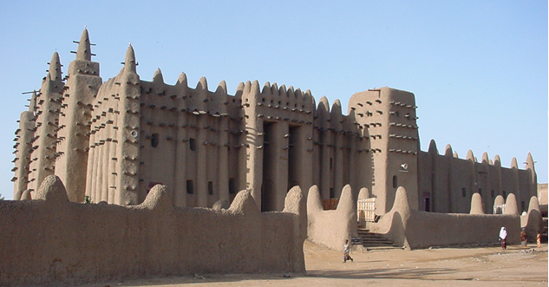
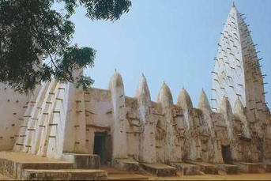
Muslim Architecture in Africa
*Architecture is the GREATEST example of cultural diffusion in the lands conquered by the Muslims (Africa).
*When mosque were constructed, Muslim culture was blended with indigenous architectural styles

Slide 12
Timbuktu
Mansa Musa built mosques at Timbuktu and made it one of the most important cities in Africa.
“There are in Timbuktu numerous judges, teachers and priest appointed by the king. He greatly honors learning. Many hand-written books imported from Barbary are also sold. There is more profit made from this commerce than from all other merchandise…..”
*This passage suggest that Timbuktu was a city that-
a. Participated frequently in war
b. Emphasized learning and trade
c. Protected the human rights of all citizens
d. Selected political leaders through democratic elections

Slide 13
Timbuktu
Mansa Musa built mosques at Timbuktu and made it one of the most important cities in Africa.
“There are in Timbuktu numerous judges, teachers and priest appointed by the king. He greatly honors learning. Many hand-written books imported from Barbary are also sold. There is more profit made from this commerce than from all other merchandise…..”
*This passage suggest that Timbuktu was a city that-
a. Participated frequently in war
b. Emphasized learning and trade
c. Protected the human rights of all citizens
d. Selected political leaders through democratic elections

Slide 14
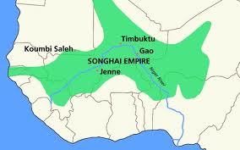
Empire of Songhai
Took over important Gold and Salt trade routes following the collapse of Mali
Songhai built impressive empire of wealth and learning but lacked modern weapons and were eventually conquered by Morocco.

Slide 15
Bantu of West Africa
*The primary reason the Bantu-speaking people of West Africa migrated southward and eastward between 500 BC and AD 1500 was to find land for farming and grazing

Slide 16
Arab Traders become Middlemen
*Once Arab traders reach Imperial China, they become the middlemen in trade between China and Europe
Who used to be the middlemen in trade?

