Slide 1
Muslim Achievements
Ch. 10 Sec. 3

Slide 2
Muhammad emphasized learning and scholarship
Medicine & Science
Math
Astronomy
Art
Philosophy
House of Wisdom
Optics

Slide 3
Golden Age of Islam
Influence of Muslims grew as the empire reached more and more people
Riches flowed into the empire from all over Europe, Asia and Africa.
Scholars preserved existing knowledge and produced an enormous body of learning
*Muslims became tolerant of several other religions
*Best known for its advances in mathematics, science and medicine

Slide 4
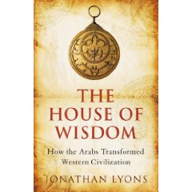
Islamic Achievements
Baghdad’s House of Wisdom
Combination library, academy, and translation center
*Translated texts from Greece, India, Persia, and other places into Arabic

Slide 5
Islamic Achievements
Medicine & Science
Solved issues through observation rather than logic
*Used experiments in lab settings(preferred method of research) to write comprehensive medical reference books

Slide 6
Islamic Achievements
Math
Believed math was the basis for all knowledge
Al-Kwarizmi developed Al-Jabr, later became Algebra
*Developed the Arabic numeral which allowed Muslim traders to interact with European merchants ( example of Islamic influence on Western civilization)

Slide 7
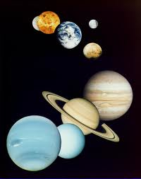
Islamic Achievements
Astronomy
Observed and charted stars, comets, and planets
*Religious obligation lead to advancement in astronomy since the Muslims must know the precise direction of Mecca during mandatory prayer

Slide 8
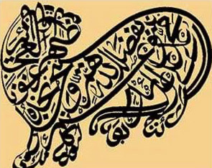
Islamic Achievements
Art
No images of people could be created because only Allah could create life
*Calligraphy (art of beautiful handwriting) became very popular
Calligraphy is the greatest form of cultural blending

Slide 9
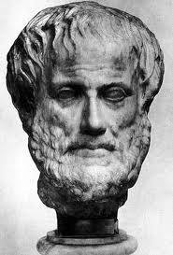
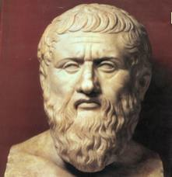
Islamic Achievements
Philosophy
Translated works of Aristotle and Plato and attempted to blend European culture with Islamic culture

Slide 10
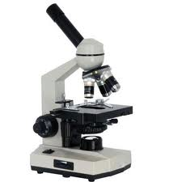
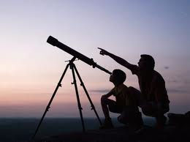
Islamic Achievements
Optics
Revolutionized ideas about vision
Developed first lenses for telescopes and microscopes

Slide 11
Quick Review
How did Islamic religious obligation lead to advancements in astronomy by Muslim scientist?
During the Golden Age of Islam, what was tolerated
Why was Baghdad’s House of Wisdom significant?

Slide 12
What was the preferred method of research of Muslim scientist?
5. The Gold Age of Islam was BEST known for advances in what 3 areas?
6. The common use of Arabic numerals in math allowed Muslim traders to do what

Slide 13
Quick Review
How did Islamic religious obligation lead to advancements in astronomy by Muslim scientist? They had to know which direction Mecca was so they could pray
During the Golden Age of Islam, what was tolerated? Other religions
Why was Baghdad’s House of Wisdom significant? Scientific and philosophical text were translated into Arabic

Slide 14
What was the preferred method of research of Muslim scientist? Experiments in a laboratory setting
5. The Gold Age of Islam was BEST known for advances in what 3 areas? Mathematics, science and medicine
6. The common use of Arabic numerals in math allowed Muslim traders to do what? Interact with European merchants

Slide 15
Muhammad emphasized learning and scholarship
Medicine & Science
Math
Astronomy
Art
Philosophy
House of Wisdom
Optics

