Slide 1
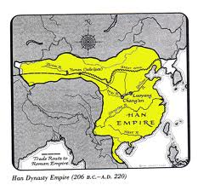
Ch. 7 Sec. 3
Han Emperors in China

Slide 2
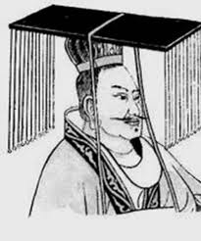
Start of Han Dynasty
Han = “the people”
Ruled China for more than 400 years
To win support of people, legalism ended
Established a centralized government: central authority controls the running of the state.

Slide 3
Han Politics
First Emperor = Lui Bang
After Emperor Bang died, his son took over. But his son was only an infant.
*Empress Lu controlled the empire for her infant son.
*Outlived her son, and continued to name one infant after another “emperor” so she can maintain her power.

Slide 4
Han Politics
*Wudi: Lui Bang’s great-grandson
Continued Centralized policies
Favored Confucian scholars at government advisors
*Improved bureaucracy by setting up schools for job applicants to study for Civil Service Exams
Expanded empire to Vietnam
Agricultural Technology increased food production = more people

Slide 5
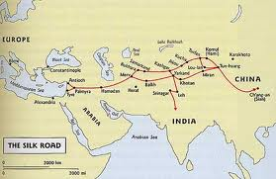
Rise of Han Economy
Silk Road: caravan route from China to Rome
Government ran huge Silk Mills
*Silk was the most valuable trade good on the Silk Road
*Silk Production was closely guarded secret!
Commerce expanded to most of Asia, through India and all the way to Rome.

Slide 6
What are our secrets?

Slide 7
Han Technology
*Innovations from the Han Dynasty
Civil Service
The Great Wall
Paper
Wheel Barrel
Silk

Slide 8
Decline of Han Dynasty
Many Historians site the following reasons for the decline:
Political crises due to civil war
Tension between social classes
Barbarian invasions by nomads

Slide 9
Chinese Dynasties Song Parody
http://youtu.be/NIC4zom3w0g

Slide 10
Ch. 12 sec 1
Two Great Dynasties in China

Slide 11
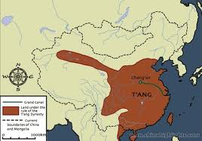
Tang Dynasty (~300 yrs)
After Han dynasty collapsed, Sui Dynasty united China
Tang Dynasty replaced Sui
*Formed by Tang Taizong
*Empress Wu Zhao (only woman emperor in China) takes over after death of Tang Taizong
Strengthened central government
Promoted foreign trade and agricultural improvements

Slide 12
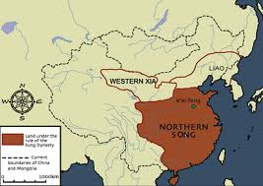
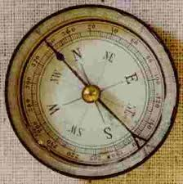
Song Dynasty: (~300 yrs)
Formed by Song Taizu
Very similar to Tang Dynasty
Korea & other territories paid tribute to Song
*China became the world’s greatest sea power because of the magnetic compass

Slide 13
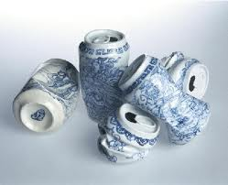
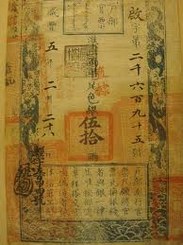
Impact of Tang & Song
*Inventions during the Tang and Song Dynasties:
Porcelain
Paper Money
Magnetic Compass
Gunpowder
Mechanical Clock
*Moveable type: made printing faster because the the individual type could be reused

Slide 14
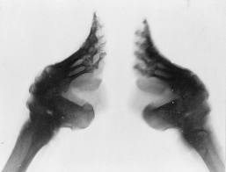
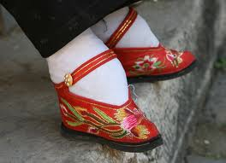
Impact of Tang & Song
Gentry could increase social status through employment or by passing the civil service exam
Women began to have less power
*Foot binding
Shows the inferiority of women
*Women were expected to dedicate their lives to the family
http://youtu.be/Qy60cJciNHQ

