Slide 1
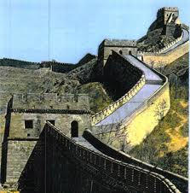
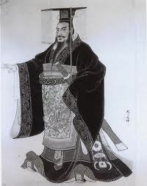
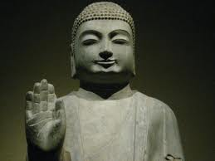
An Empire Unifies China
Zhou and Qin Dynasties

Slide 2
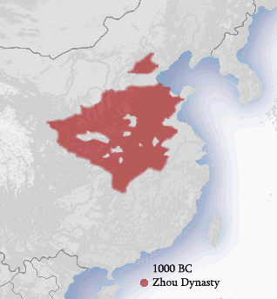
Zhou Dynasty
Ruled China from 1027 BC to 256 BC
Did not follow Chinese values of social order, harmony, and respect for authority

Slide 3
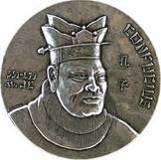
Confucius
China’s most influential scholar
*Wanted to restore China’s ancient values of conformity and respect
Confucianism became foundation for Chinese government and social order
Bureaucracy – civil service exam to see who can get governments jobs
Education became very important in order to get better jobs
*The teaching of Confucius had a philosophical impact on China giving the Scholars higher status

Slide 4
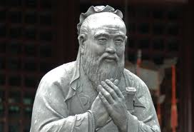
Confucius
*Believed social order, harmony, and good government could be restored in China if society was organized around five basic relationships.
Ruler and Subject
Father and Son
-Filial Piety – respect for parents/elders
Husband and Wife
Older Brother and Younger Brother
Friend and Friend

Slide 5
*Yin and Yang
*Two powers that represented the natural rhythms of life
Yin = feminine
Yang = masculine
Both complement/complete each other

Slide 6
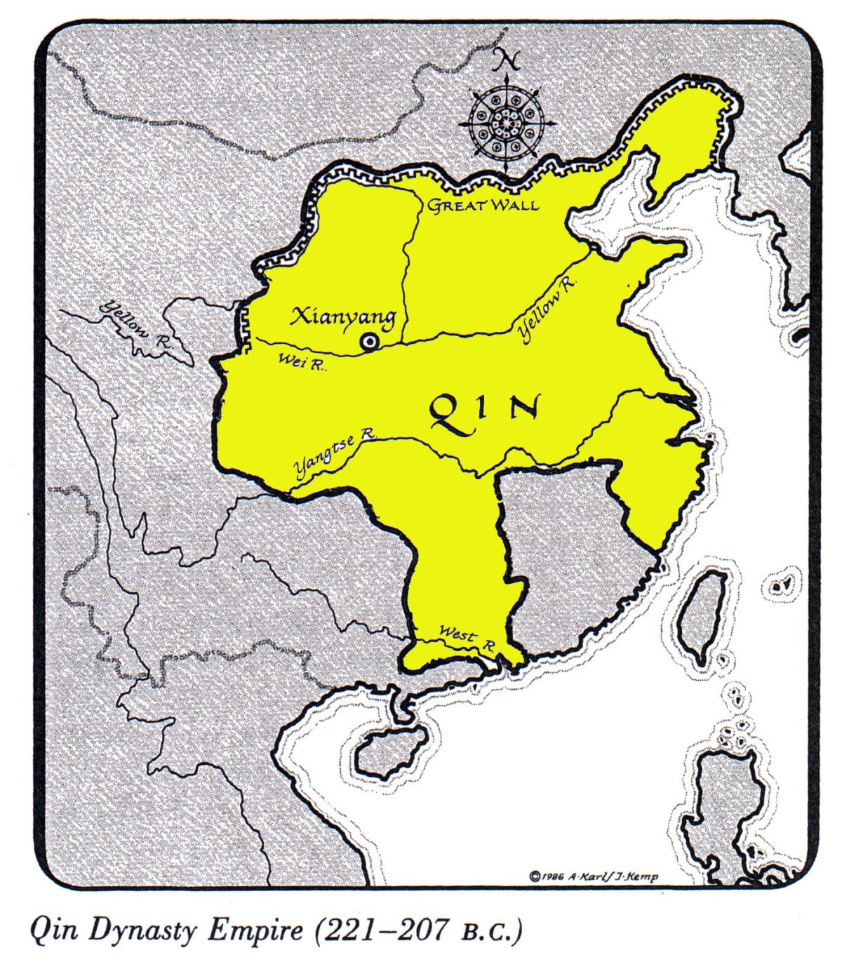
Qin Dynasty
Replaced Zhou Dynasty
*Shi Huangdi – First Chinese Emperor
Began rule at age 13
Employed Legalist ideas

Slide 7
Qin Dynasty
Highly efficient and powerful government that crushed opponents
Burned books by Confucius and other people who disagreed with the Emperor
Established an autocracy

Slide 8
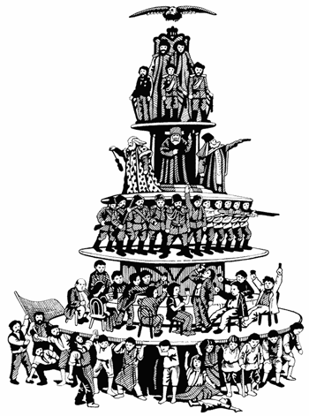
Autocracy
*A government in which the ruler has unlimited power and uses it in an arbitrary manner
How does the cartoon represent an autocracy?

Slide 9
Qin Dynasty
Set uniform standards for writing, law, currency, and measures
Forced peasants to build over 4,000 miles worth of roads
Irrigation systems helped improve farm production
*Used forced labor to build the Great Wall of China to prevent invaders from entering China

Slide 10
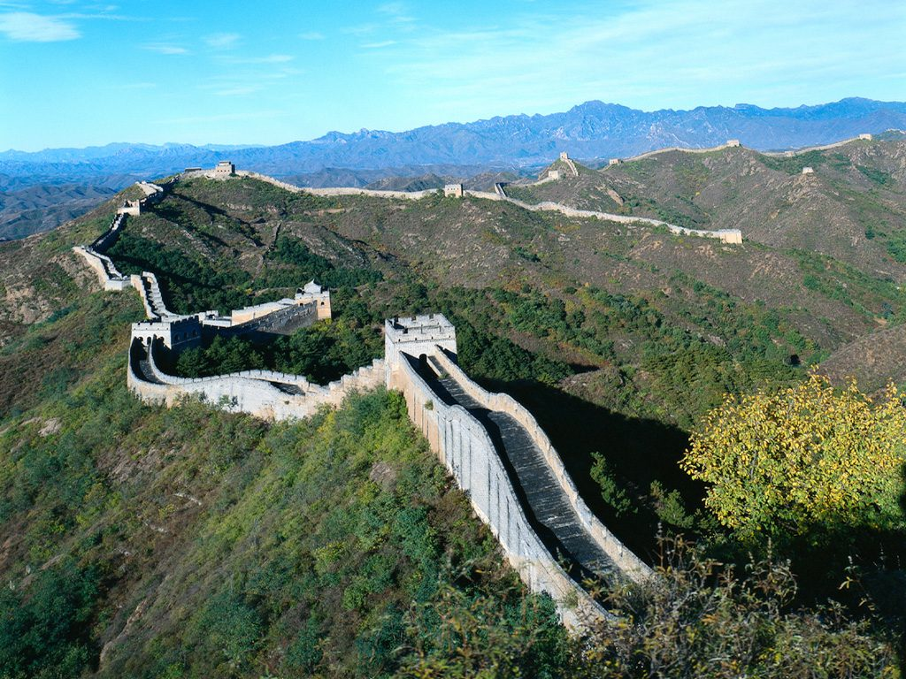
Great Wall of China
Built by peasants who were forced to work or face death
1,400 miles long and 20-25 ft. high
Visible from space

